Slide 1

CERTIFICATE III IN AUTOMOTIVE REPAIR & MAINTENANCE
SUBJECT: VEHICLE MAINTENACE AND REPAIR
By Ibrahim siraj
Maldives polytechnic

Slide 2
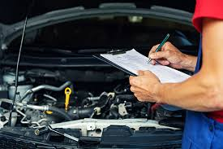
VEHICLE MAINTENACE AND REPAIR
Chapter 4 Undertake Inspection and Service Engine
Introduction
Engine inspection is the process of a technician checking an engine's components for wear and proper function, while engine service involves performing maintenance tasks like changing oil and fluids to keep the engine running smoothly. Inspections aim to identify potential problems, while services are preventative and restorative actions to maintain optimal performance and prevent costly repairs
By Ibrahim siraj
Maldives polytechnic

Slide 3
VEHICLE MAINTENACE AND REPAIR
Chapter 4 Undertake Inspection and Service Engine
Engine Inspection
Inspection is a proactive assessment process that involves a detailed look at the engine's various systems and components to detect signs of wear, damage, or malfunction before they lead to major problems
Key aspects of an engine inspection include
Visual Checks: Mechanics look for physical signs of wear and tear, such as cracks in belts and hoses, corrosion on electrical components, or obvious fluid leaks around seals and gaskets.
Fluid Level and Quality Checks: Engine oil, coolant, brake fluid, and other vital fluids are checked for proper levels and contamination.
Diagnostic Testing: Modern vehicles have on-board diagnostic (OBD) systems. Technicians use specialized tools to scan for error codes stored in the car's computer, which helps pinpoint non-visible issues.
By Ibrahim siraj
Maldives polytechnic

Slide 4
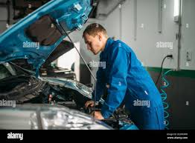
VEHICLE MAINTENACE AND REPAIR
Chapter 4 Undertake Inspection and Service Engine
Engine Inspection
Visual Checks: Mechanics look for physical signs of wear and tear, such as cracks in belts and hoses, corrosion on electrical components, or obvious fluid leaks around seals and gaskets.
Leaks: Look for oil or coolant stains on the engine block, gaskets, and the ground below the car. Check around seals and gaskets for signs of active leaks.
Damage and wear: Inspect engine mounts, brackets, and the engine block for cracks, corrosion, or excessive wear. Check for physical damage like a dented oil pan, which may indicate abuse.
Cleanliness: A clean engine can indicate good maintenance, but a greasy or dirty engine can suggest neglect or a hidden leak. Look for sloppy assembly, such as excess sealant oozing out.
Hoses and belts: Check all belts for signs of wear, cracking, or damage, and ensure hoses are flexible and not brittle.
Fasteners: Ensure all bolts and nuts are present, tight, and free of corrosion
By Ibrahim siraj
Maldives polytechnic

Slide 5
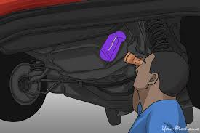
VEHICLE MAINTENACE AND REPAIR
Chapter 4 Undertake Inspection and Service Engine
Engine Inspection
Visual Checks: Mechanics look for physical signs of wear and tear, such as cracks in belts and hoses, corrosion on electrical components, or obvious fluid leaks around seals and gaskets.
Fluid checks
Engine oil: Open the oil cap and check for a white, milky residue, which can indicate that coolant has mixed with the oil due to a blown head gasket.
Coolant: Check the coolant in the reservoir. It should have a proper color and not contain any oil
By Ibrahim siraj
Maldives polytechnic

Slide 6
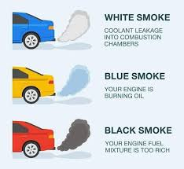
VEHICLE MAINTENACE AND REPAIR
Chapter 4 Undertake Inspection and Service Engine
Engine Inspection
Visual Checks: Mechanics look for physical signs of wear and tear, such as cracks in belts and hoses, corrosion on electrical components, or obvious fluid leaks around seals and gaskets.
Running the engine
Exhaust smoke: Start the engine and observe the exhaust.
Blue smoke: Suggests the engine is burning oil, possibly due to leaking valve seals or worn piston rings.
White smoke: Can indicate a head gasket leak, allowing coolant to enter the combustion chamber.
Black smoke: Points to a rich fuel mixture.
By Ibrahim siraj
Maldives polytechnic

Slide 7
VEHICLE MAINTENACE AND REPAIR
Chapter 4 Undertake Inspection and Service Engine
Engine Inspection
Fluid Level and Quality Checks: Engine oil, coolant, brake fluid, and other vital fluids are checked for proper levels and contamination.
General Preparation Steps
Park on a level surface: This ensures accurate readings.
Let the engine cool (mostly): For most fluids (engine oil, coolant, brake fluid), the engine should be off and cool to prevent burns and get an accurate level reading.
Locate the reservoirs/dipsticks: Most are clearly marked with symbols or labels in the engine bay.
Use a clean rag/paper towel: You will need this to wipe dipsticks clean
By Ibrahim siraj
Maldives polytechnic

Slide 8
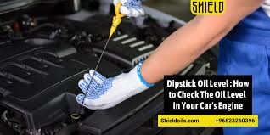
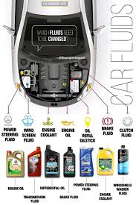
VEHICLE MAINTENACE AND REPAIR
Chapter 4 Undertake Inspection and Service Engine
Engine Inspection
Specific Fluid Checks
By Ibrahim siraj
Maldives polytechnic

Slide 9
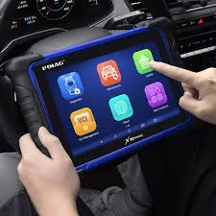
VEHICLE MAINTENACE AND REPAIR
Chapter 4 Undertake Inspection and Service Engine
Engine Inspection
Diagnostic Testing: Modern vehicles have on-board diagnostic (OBD) systems. Technicians use specialized tools to scan for error codes stored in the car's computer, which helps pinpoint non-visible issues.
The systems covered can include:
Engine (misfires, timing, fuel efficiency)
Transmission (shifting issues, fluid levels)
Braking system (ABS issues, sensor failures)
Exhaust system (oxygen sensors, catalytic converter issues, emissions)
Electrical system (battery, alternator, wiring faults)
Body systems (air conditioning, airbags, driver assistance)
By Ibrahim siraj
Maldives polytechnic

Slide 10
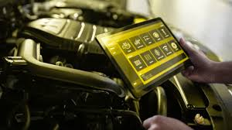
VEHICLE MAINTENACE AND REPAIR
Chapter 4 Undertake Inspection and Service Engine
Engine Inspection Diagnostic test
The systems covered can include:
While many drivers wait for the check engine light or other warning lights to illuminate, diagnostic tests can also be part of a preventative maintenance routine. You should consider a diagnostic test if you notice:
A steady or flashing check engine light.
Rough idling, stalling, or engine misfires.
Unexplained drops in fuel economy.
Unusual noises, vibrations, or smells.
Difficulty starting the car
By Ibrahim siraj
Maldives polytechnic

Slide 11
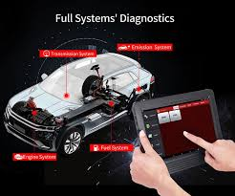
VEHICLE MAINTENACE AND REPAIR
Chapter 4 Undertake Inspection and Service Engine
Engine Inspection Diagnostic test
Performing a DIY Diagnostic Test
Locate the OBD port: Check your owner's manual to find the port, typically under the dashboard or near the steering column.
Connect the scanner: Ensure the car is off, plug the scanner's 16-pin connector into the port.
Power the vehicle: Turn the ignition on (but not the engine).
Read the codes: Follow the scanner's on-screen instructions to retrieve the "Codes" or "Trouble Codes
By Ibrahim siraj
Maldives polytechnic

Slide 12
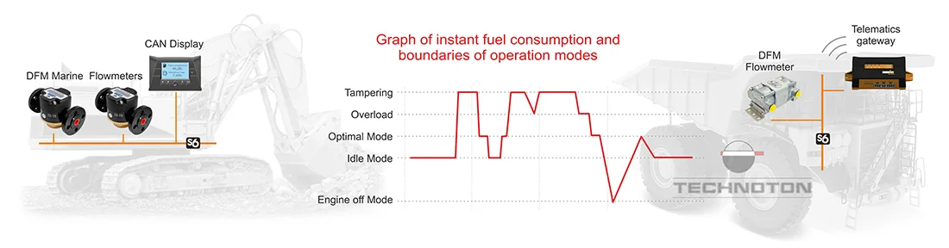
VEHICLE MAINTENACE AND REPAIR
Chapter 4 Undertake Inspection and Service Engine
Engine Inspection
Performance Monitoring: This can involve listening for unusual noises (knocking, squealing), checking for vibrations, and sometimes conducting a test drive or compression tests to evaluate engine operation
By Ibrahim siraj
Maldives polytechnic

Slide 13
VEHICLE MAINTENACE AND REPAIR
Chapter 4 Undertake Inspection and Service Engine
Engine Service
Engine service involves the practical actions taken to address the findings of an inspection and perform regular maintenance tasks to keep the engine running smoothly and efficiently. It can be preventive or corrective (repair)
Oil and Filter Change: The most fundamental service, involving draining old oil and replacing the oil filter and oil to ensure proper lubrication and reduce friction.
Filter Replacement: Replacing the air filter and fuel filter to ensure a clean supply of air and fuel to the engine.
Replacement of Worn Parts: Swapping out components prone to wear, such as spark plugs, drive belts, and hoses, at recommended intervals.
Fluid Top-ups and Flushes: Topping up all fluids and performing system flushes (e.g., cooling system, brake system) as needed.
Adjustments and Cleaning: This may involve cleaning the fuel system to remove deposits or adjusting the idle speed and ignition timing
By Ibrahim siraj
Maldives polytechnic

Slide 14
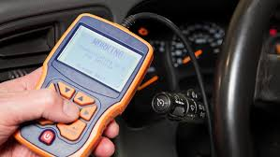
VEHICLE MAINTENACE AND REPAIR
Chapter 4 Undertake Inspection and Service Engine
Engine Service
Engine service involves the practical actions taken to address the findings of an inspection and perform regular maintenance tasks to keep the engine running smoothly and efficiently. It can be preventive or corrective (repair)
By Ibrahim siraj
Maldives polytechnic

Slide 15
THANK YOU

